Slide 1
Gender of nouns

Slide 2
Nouns
What is a noun?
All nouns in Spanish have a designated gender.
They are either masculine or feminine.

Slide 3
ARTICLES
In English we say, “the table,” or “the cat.”
The word “the” is called an article.
The Spanish articles are “el” for masculine nouns and “la” for feminine nouns.
The table = la mesa, the cat = el gato

Slide 4
Gender of nouns is NOT a way of labeling something as a girl thing or a boy thing (unless it is a living thing). It is simply a way of organizing words. Sometimes it feels like when they were creating Spanish, they threw all the nouns up in the air then randomly assigned which ones were masculine and which ones were feminine.

Slide 5
THE BEST THING I CAN TEACH YOU ABOUT THIS:
When you learn a new word that is a noun, memorize its article
When you learn a new word that is a noun, memorize its article
When you learn a new word that is a noun, memorize its article
When you learn a new word that is a noun, memorize its article
When you learn a new word that is a noun, memorize its article
When you learn a new word that is a noun, memorize its article
When you learn a new word that is a noun, memorize its article
When you learn a new word that is a noun, memorize its article

Slide 6
THE BASICS
A general rule…
If it ends in –o it is masculine.
If it ends in –a it is feminine.
This is not always the case, but it is a good starting point.

Slide 7
Practice: Fill in the blank
_____ camisa
_____ ropa
_____ vestido
_____ corbata
_____ abrigo
_____ bulsa
_____ bolsillo
_____ falda
_____ seda
_____ chaleco

Slide 8
Living Things: it is a way of labeling something as male or female
When the noun is a living thing, it changes depending on if the living thing is male or female.
Masculine:
el gato – the male cat el perro – the male dog el chico – the boy el abuelo – grandfather
Feminine
la gata – the female cat la perra – the female dog la chica – the girl la abuela - grandmother

Slide 9
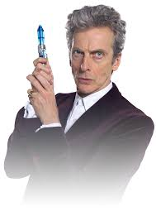
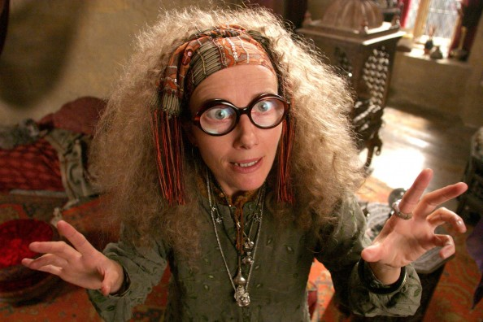
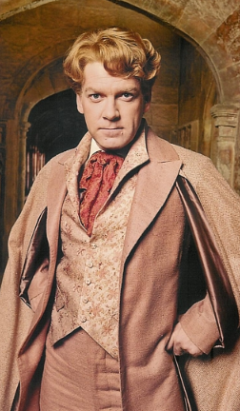
Some examples:
El doctor
El profesor
La profesora
La doctora

Slide 10
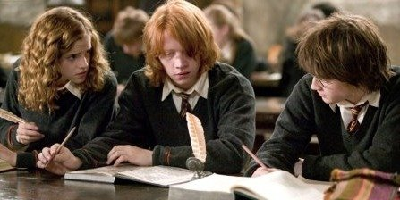
There are words that only the article changes to indicate gender
Examples:
el estudiante la estudiante
el pianista la pianista
el artista la artista
La estudiante
El estudiante

Slide 11
Not living things
You cannot guess if it is masculine or feminine. Sometimes there are rules and sometimes there aren’t. Which is why:
When you learn a new word that is a noun, you must memorize its article
The word for dress is “vestido”. Even though it is a thing women often wear, the word in masculine.

Slide 12
Sometimes Rules
Words that end in –ma are sometimes MASCULINE
el telegrama
el programa
el problema
el sistema
el poema
el idioma
el clima
el tema
This is because the words are of Greek origin.

Slide 13
But not always…
A few nouns that end in -ma are feminine, such as:
la cama
la pluma.

Slide 14
Sometimes Rule
It is mostly masculine if…
it ends in an -e
it ends in a consonant other than –z or –d
it ends in an accented vowel

Slide 15
4 words that end in –a that are masculine
el día
el mapa
el planeta
el sofá

Slide 16
ALWAYS Rule underlined, starred, circled, and written 17 times.
If the word ends in:
-dad
-tud
-tad
-sión
-ción
-umbre
It is ALWAYS feminine
la televisión
La conversación
la ciudad
la dificultad
la gratitud
la certidumbre

Slide 17
Another feminine sometimes rule
If it ends in z or d it is often, but not always, feminine.
La paz
La felicidad

Slide 18
2 words that end in –o that are feminine and must be memorized
la mano
la radio

Slide 19
Review
Many nouns that denote living things have both a masculine and a feminine form.
Most nouns that end in -o are masculine.
Most nouns that end in -a are feminine.
Masculine nouns that end in a consonant often have a corresponding feminine form that ends in -a.
Some nouns that refer to people use the same form for both masculine and feminine. These nouns indicate gender by the article (el or la).
Nouns that end in -sión, -ción, -dad, -tad, -tud, -umbre are feminine.
Many nouns that end in -ma are masculine.
A few nouns that end in -o are feminine

Slide 20
Adjectives
Spanish adjectives must match the nouns they describe in both gender and number. For example, apples (manzanas ) are feminine in Spanish, so this word must be used with feminine articles like la , las , and una. Any adjective used to describe an apple in Spanish must also be feminine (for example roja ). On the other hand, bananas (plátanos ) are masculine, and must be used with masculine articles and adjectives

