Slide 1
Adjective agreement homework

Slide 2
Adjective agreement Homework
Adjectives must agree in number and in gender with the noun. Nouns always win.
Instructions for this homework:
Find three characters or people that you like. Describe each with three sentences, making sure the adjectives agree in number and gender.
You will turn in a handwritten paper that has your three people and their descriptions written down. Also be prepared to tell the class about your person.

Slide 3
Some helpful words and phrases
He = Él
Notice the accent, this is what makes it different than the word for “the”
She = Ella
Has = tiene
Is for permanent things = es
Ex: Él es feliz = he is a happy person
Is for not permanent things = está
Ex: Él está feliz = he is happy today
For finding the adjectives and other words you may need, please use wordreference.com or spanishdict.com. Both have apps you can download for your phone or tablet.

Slide 4
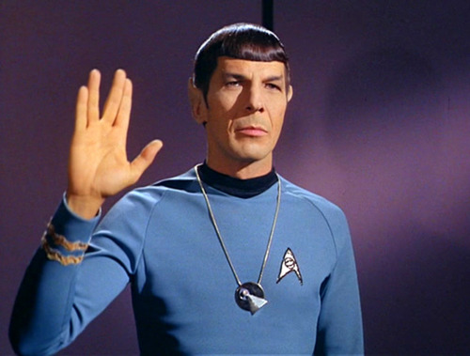
Spock
Spock es lógico.
Spock is logical.
Él tiene pelo oscuro.
He has dark hair.
Él tiene un amigo humano.
He has a human friend.

Slide 5
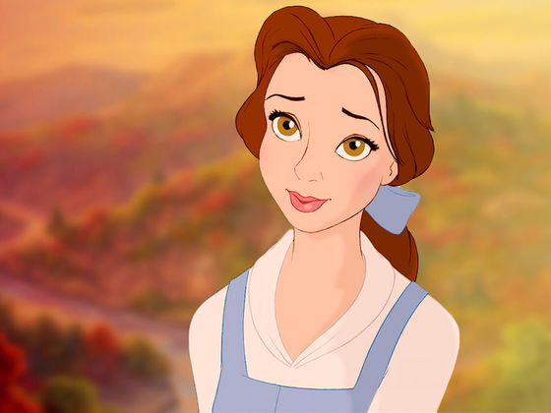
Belle
Belle es bella.
Belle is pretty.
Ella es aventurera
She is adventurous.
Ella tiene ojos morenos.
She has brown eyes.

Slide 6
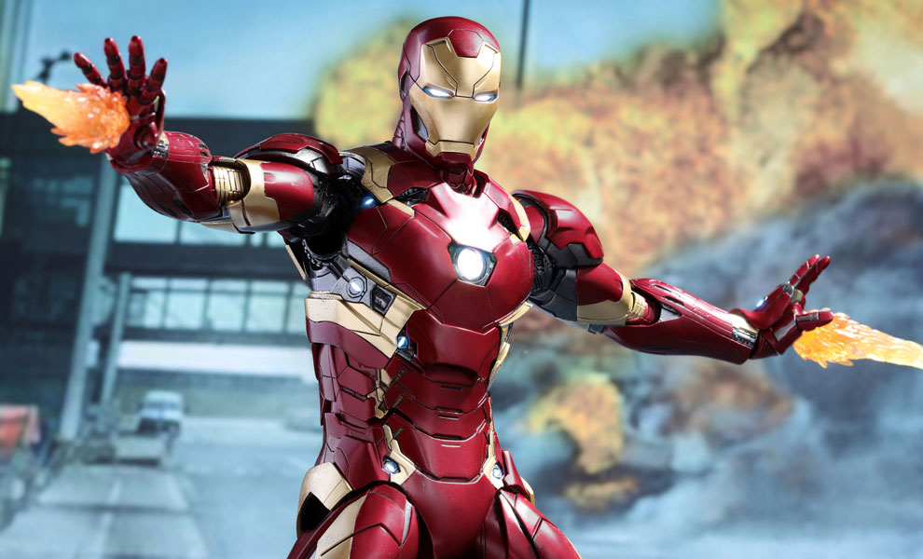
Iron man
Iron Man es rico.
Iron Man is rich.
Él es valiente.
He is brave.
Él tiene una barba oscura.
He has a dark beard.

